Slide 1
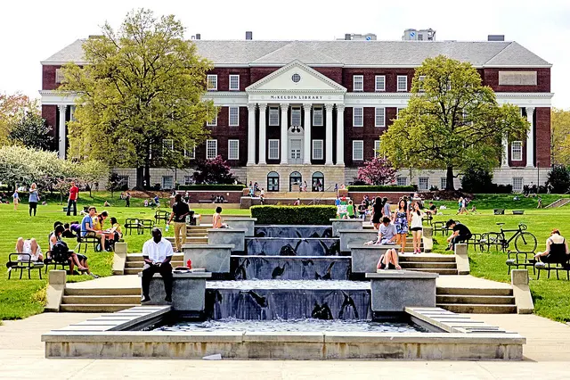

Info Challenge
Global Classroom Analysis for UMD GCI
Team ic23019
Notes:
Hi everyone, we are team IC 23919, and we are going to talk about the analysis we have done which identifies the general trends of students who took Global Classes (GC) at the University of Maryland during two academic years since the Fall 2020 semester.

Slide 2




Our Team: ic23019
Kyungho Daniel Yu
MS Business Analytics in
Robert. H Smith Business School
at University of Maryland, College Park
Jaehyun Joey Lee
MS Business Analytics in
Robert. H Smith Business School
at University of Maryland, College Park
Eojin Ellie Kim
MS Information Systems in
Robert. H Smith Business School
at University of Maryland, College Park
Notes:
Before getting started, let me introduce our team. I am Dan yu, majoring in Business Analytics.
and this is….

Slide 3
INDEX
01
Loading Global Classroom Data
Exploratory Data Analysis
Key Takeaway
Suggestion
02
03
04
Notes:
Now, let’s getting started. we have four sections today.
First…
Second..

Slide 4
Loading
Global Classroom Data

Slide 5
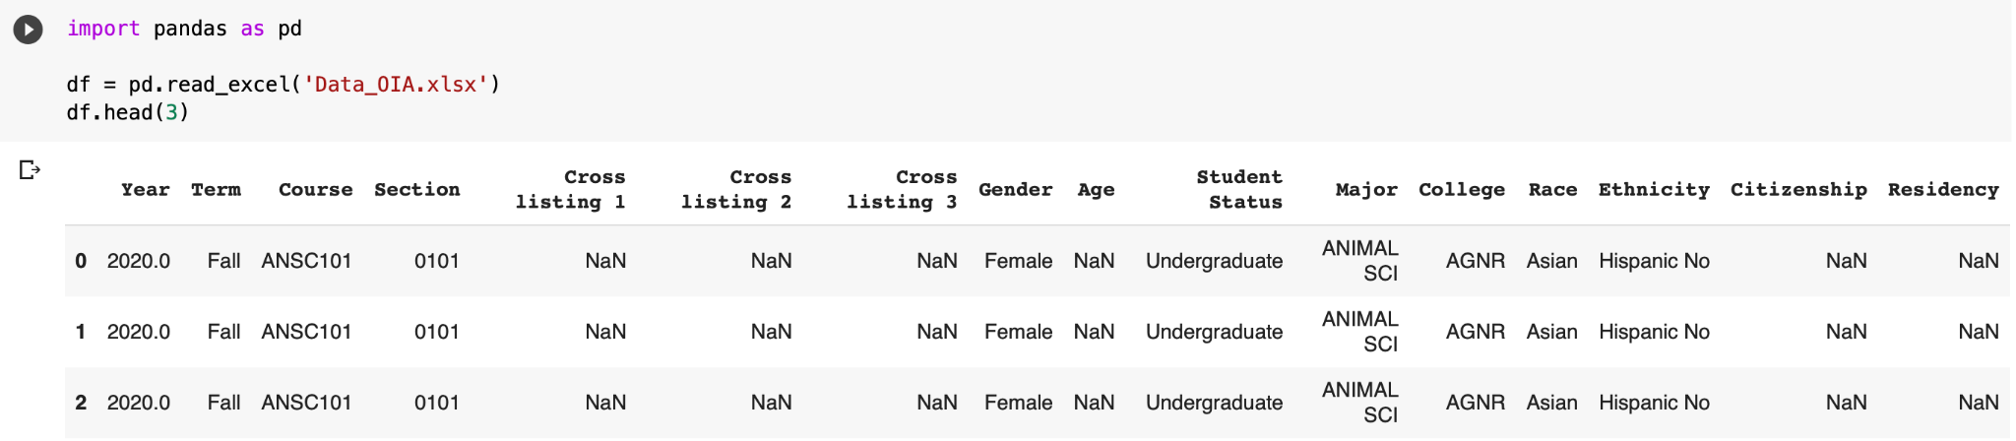
Loading Data
Notes:
Let me talk about how the data looks like. this is the raw data which the global classroom provided for the challenge. As you can see, there are 16 columns here such as ….. But, we can see there are missing data already. So, we decided to find which columns have missing data and how to manipulate it.

Slide 6
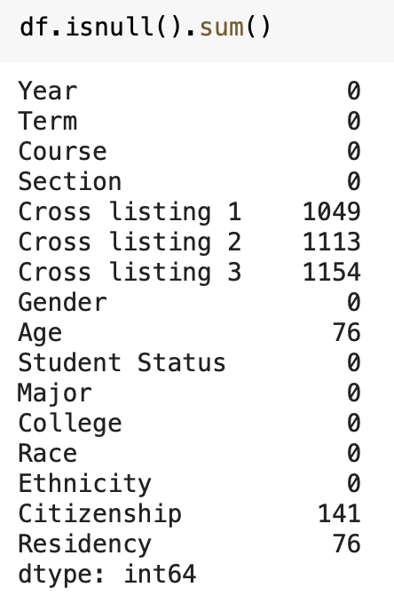
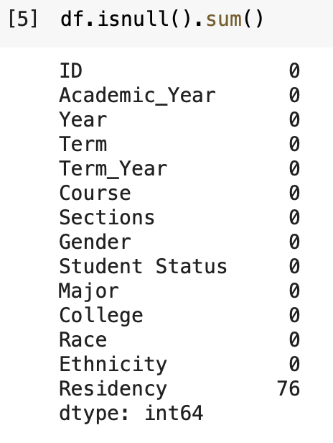
Finding Missing Data and Manipulating
Notes:
So, we found a lot of missing data on 6 columns such as cross listing 1,2,3 / Age / Citizenship / and residency. However, when we take a look at the data, the 6 columns which have missing data are not that significant variables for finding an insight, so we decided to drop those variables, but we added a unique identifier which is the ID column for getting some quantitative insights. Even if we cleaned up the data, there are still missing data on Residency column. The reason why we decided to keep this missing data is because it’s only one period, and it does not give any error on the insights.

Slide 7
Exploratory Data
Analysis (EDA)
Notes:
Now, im going to talk about the Exploratory data analysis.

Slide 8
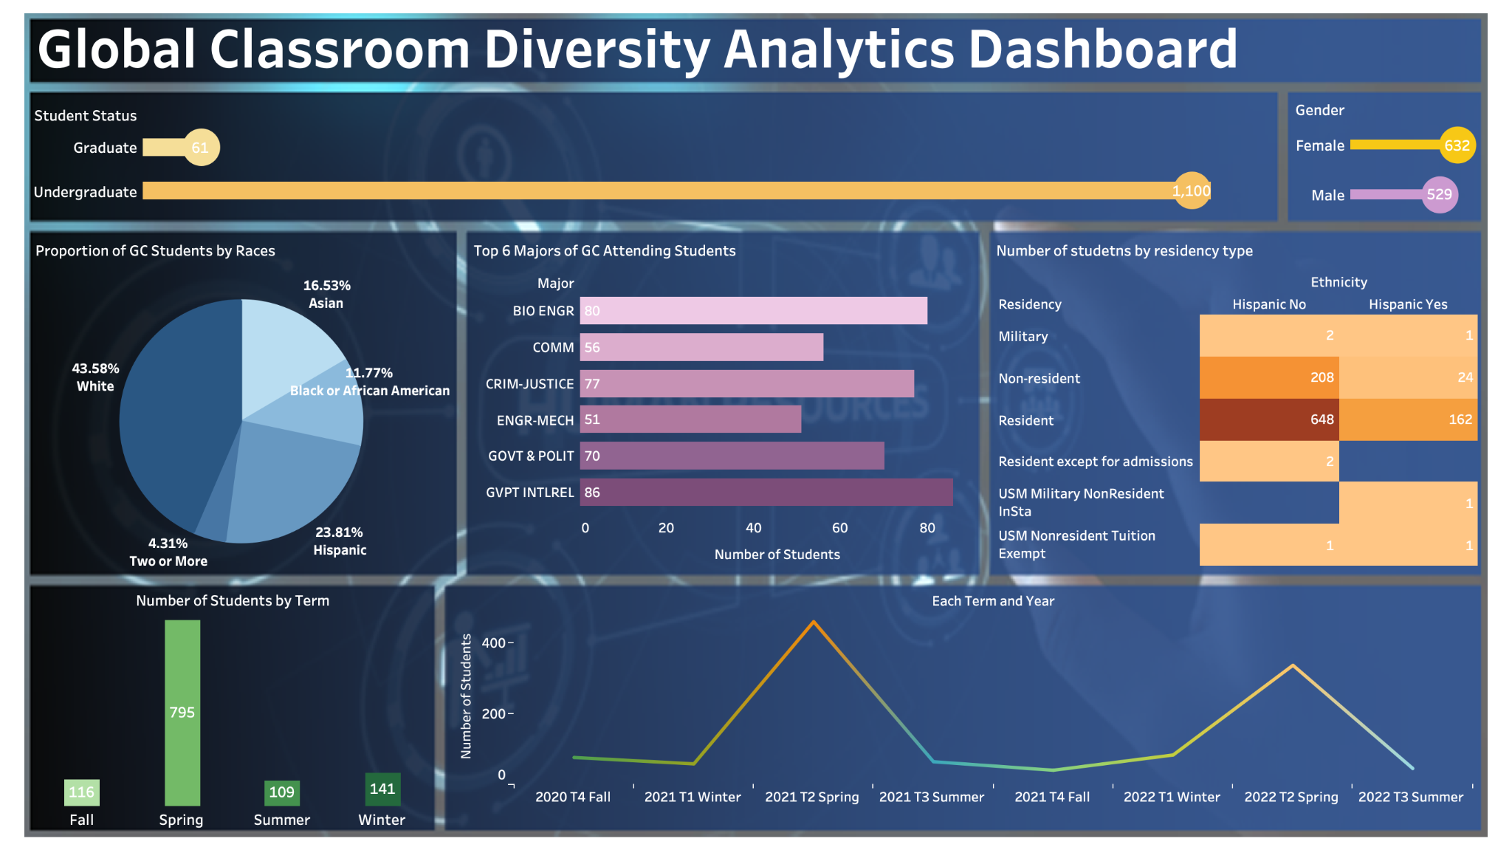
Notes:
After data manipulation, we created a dashboard with Tableau which says about the diversity Analytics about the Global Classroom. From this dashboard, we found three significant quantitative insights.
First of all, we can see the majority of students of GC are Undergraduate. About 95% of students from undergraduate.
Second, we can see the about 70% of students have taken GC courses on Spring semester.
Third, we can see there are two big swings on the very last line chart. which says the highest number of students have taken GC appear on spring 2021 and 2022.

Slide 9
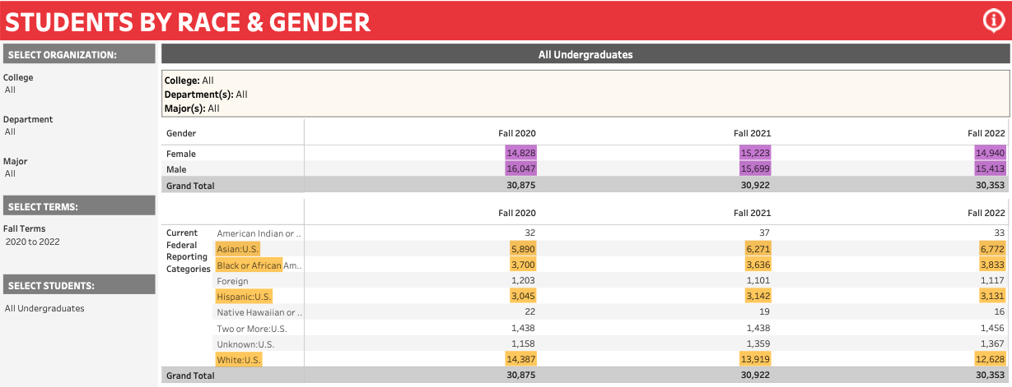
Data source: University of Maryland
Notes:
After data manipulation, we created a dashboard with Tableau which says about the diversity Analytics about the Global Classroom. From this dashboard, we found three significant quantitative insights.
First of all, we can see the majority of students of GC are Undergraduate. About 95% of students from undergraduate.
Second, we can see the about 70% of students have taken GC courses on Spring semester.
Third, we can see there are two big swings on the very last line chart. which says the highest number of students have taken GC appear on spring 2021 and 2022.

Slide 10
Key Takeaways
Why & How
Notes:
Hi, My name is Eojin, and I’ll take the two open questions we devised along with this trends analysis. While we’re doing EDA to catch the trends of students who took Global classes from Fall 2020 to Summer 2022, we continuously questioned ourselves about “what Global Classroom Initiatives wants from this analysis

Slide 11
Objectives of Global Classroom
01
Communicate and engage with faculty interested in participating in GC as well as
institutional authorities
devise steps to provide “Global Learning for all” to every UMD student
02
Notes:
So, we came back to the beginning and looked again at the objectives of the Global classroom from understanding student diversity trends for the previous two academic years of GC. What they tried to do was 1) devise steps to provide Global Learning for all to every UMD student, and second, Communicate and engage with faculty Interested in participating in GC, as well as institutional authorities. We understand that these two objectives say in common that they want to deliver global classes to all UMD students in an effective way. From this, what we’re focused on is

Slide 12
Objectives of Global Classroom
01
Communicate and engage with faculty interested in participating in GC as well as
institutional authorities
devise steps to provide “Global Learning for all” to every UMD student
02
“ Class Expansion ”
Notes:
“Class Expansion”
We thought that to achieve GCI’s objective, which is “provide GC to all and every UMD student,” the first and the most important thing to do is to expand the number of Global Class. Therefore, we set our own objective for this challenge, “build strategies for successful Class Expansion,” and devised two open questions

Slide 13
WHY
01
: Why “Class Expansion” is IMPORTANT to achieve GCI’s Objectives?
HOW
02
: How GCI can achieve “Class Expansion” ?
Notes:
With the theme of Why and How.
So these are our two open questions:
Why Class Expansion is important to achieve GCI’s objectives
How GCI can achieve Class Expansion
I’ll talk about Why questions first with some table.

Slide 14
 | Term_Year | Number of Courses Opened | Number of Students who took CG
1 | Fall 2020 | 17 | 76
2 | Fall 2021 | 12 | 40
3 | Winter 2021 | 9 | 64
4 | Winter 2022 | 6 | 45
5 | Spring 2021 | 20 | 459
6 | Spring 2022 | 15 | 336
7 | Summer 2021 | 5 | 58
8 | Summer 2022 | 9 | 83
Notes:
As you can see, we divided data into each term and academic year. these two colored parts show the regular semesters, Fall and Spring.
During Fall 2020 semester, the 17 GC courses were opened, and 76 students took the classes. On the other hand, only 12 GC were opened in Fall 2021 semester (the next academic year), and 40 students took GC. When 5 classes were reduced during fall 2021, the number of students enrolled in GC also decreased.
We can see the same situation in the Spring semester. When we saw the Spring 2021, 20 GC were opened, and 459 students took them. However, during Spring 2022, five fewer courses, which is 15 GC, were opened, and 123 fewer students took GC in that semester.

Slide 15
 | Term_Year | Number of Courses Opened | Number of Students who took CG
1 | Fall 2020 | 17 | 76
2 | Fall 2021 | 12 | 40
3 | Winter 2021 | 9 | 64
4 | Winter 2022 | 6 | 45
5 | Spring 2021 | 20 | 459
6 | Spring 2022 | 15 | 336
7 | Summer 2021 | 5 | 58
8 | Summer 2022 | 9 | 83
Notes:
We can also see the same tendency in the winter and summer semesters. As more classes were opened, more students took GC in that semester.
Therefore, we find the trends that if GCI open more Global class in a certain semester, more students will take GC. This is why the Class expansion is important to provide GC to all and every UMD student.

Slide 16
How Effectively?
Seasonality!
Notes:
Hi, my name is Joey, Our second key takeaway is about "How Global classrooms can achieve expansion in an effective way."
We found the answer in seasonality. Global classroom students surprisingly increased in one specific semester. We simply calculated the number of students per one course for each season. Then, we could see this number.

Slide 17
Semester | # of Student / course
Fall | 4.1
Spring | 22.7
Summer | 7.3
Winter | 10.1
x 5
x 3
x 2
Notes:
The spring semester has attracted more than twice students than any other season in average. Then, let's look at the detail from the chart by semester.

Slide 18
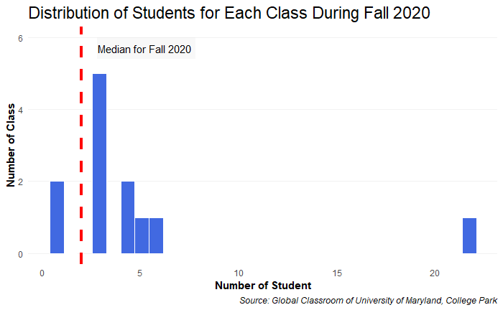
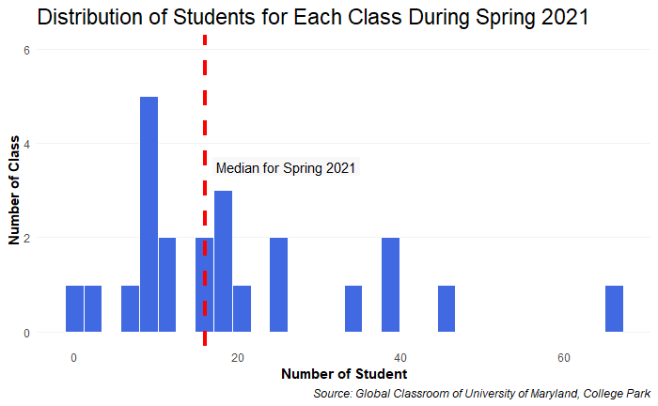
Check the “Median”
Median in Fall 2020: 2
Median in Spring 2021: 16
Notes:
If you opened a class in Fall 2020, you could expect roughly 2 students. But if you opened the following spring, you could expect 16.

Slide 19
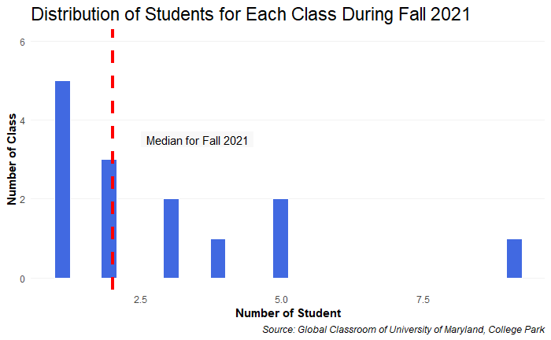
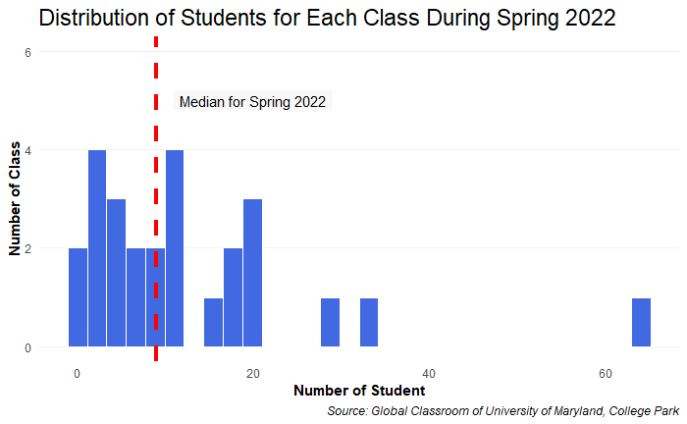
Median in Fall 2021: 2
Median in Spring 2022: 9
Notes:
Likewise, 2 students in Fall 2021, while 9 in Spring 2022.
The data is telling us that students flock to the global classroom in Spring! If there is a guarantee that many students will take classes, the advantages of Global classrooms will be much more prominent. Especially for faculty and authorities because they are direct stakeholders.

Slide 20
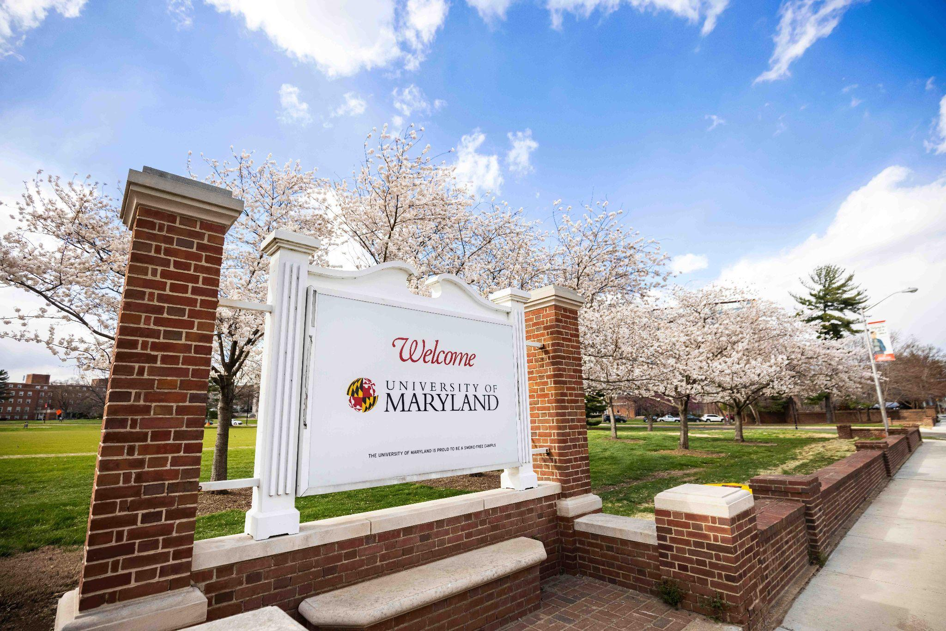
Notes:
For them, the Spring will be the festival.

Slide 21
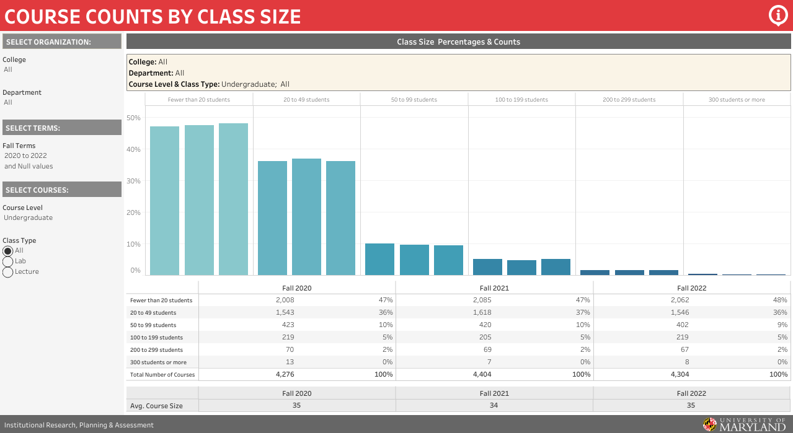
Notes:
This chart is about the student number of all the UMD classes for the undergraduate. As we highlighted, 47% has less than 20, and 36% has 20 to 49 students. 85% of total.

Slide 22
Performance..?
Notes:
Assuming that the number of students is a kind of performance, spring is the only semester that shows similar performance to general classes.

Slide 23
“ Promotion Opportunity ”
Notes:
But, this as an opportunity. It would be effective to open more Global classrooms in spring to expose them to students. If there are more people who know Global classroom and they attend it, other semesters will also enjoy the effect.

Slide 24
Suggestion
Notes:
So, here is our final suggestion. The client of this analysis is the Global learning initiaves of UMD
And this suggestion considers their interest of UMD students and stakeholders.

Slide 25
Expand
Gen Ed
Spring
Notes:
Expand courses as many as possible, with GE credits, in the spring. We assure it will help them achieve their own goal.

Slide 26

We appreciate your questions
Notes:
Thank you for listening, and we appreciate your questions.

